Slide 1
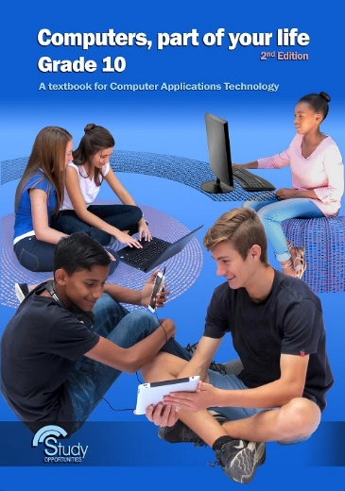
Module 1.5 ICT in perspective

Slide 2
contents
Types of computers
What is ICT?
Ethical use of computers
Test and improve
Written module activity

Slide 3
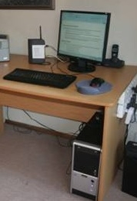
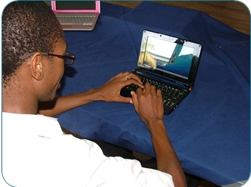
Types of computers
General-purpose computers
Desktop computers
Laptops, tablets, notebooks
screen
keyboard
mouse
‘box’(system unit) containing CPU, memory, storage
work anywhere,
at any time

Slide 4
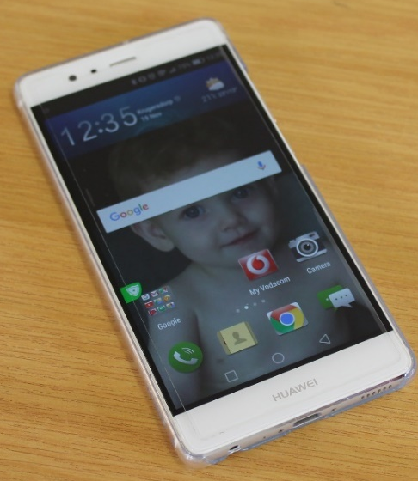
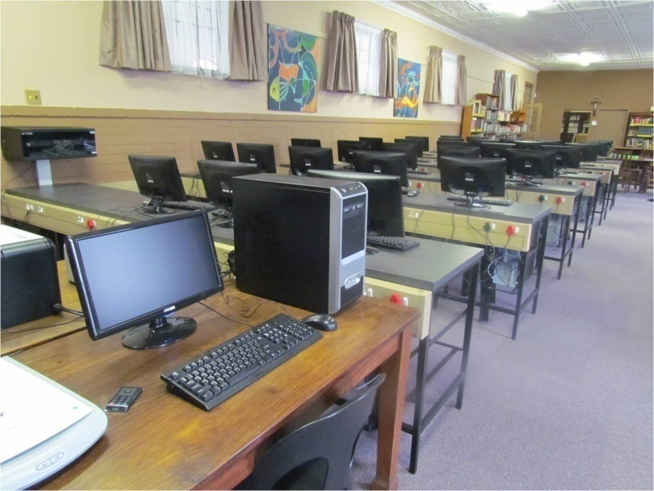
Types of computers
General-purpose computers – cont.
Smartphone
Server
Multi-purpose computing device that can also be used as a phone
Computer on a network that provides resources and services to connected computers and users

Slide 5
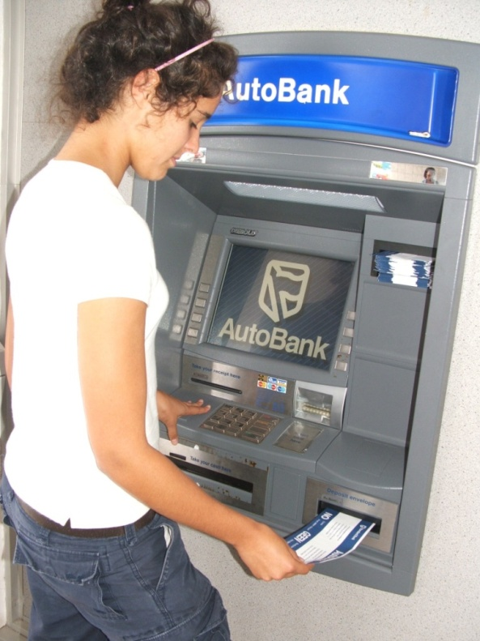
Types of computers
Dedicated devices
MP3 players
GPS devices
ABS braking system in your car
ATM machines
Household appliances like microwaves and washing machines

Slide 6
What is ICT?
Information
Manipulated or processed data
Communication
Process of transferring data / information from one place to another
Technology
System – Hardware and Software
Communication – Networks and communication devices
Internet – WWW, e-communication

Slide 7
What is ICT?
Why do we need information?
Information is power and creates the potential for wealth
ICTs are both part of and affect our everyday lives.

Slide 8
ICT SYSTEMS
Processing (Working with data and information)
Output
(Showing results)
Input
(Data collected)
Storage
(Permanent)
Communication
(sending results)
People
(Users, clients, customers, operators, etc.)

Slide 9
ICT SYSTEMS
An ICT system is a combination of hardware, software, data, processes and people with the goal of:
collecting
processing
storing
retrieving and
communicating data and information

Slide 10
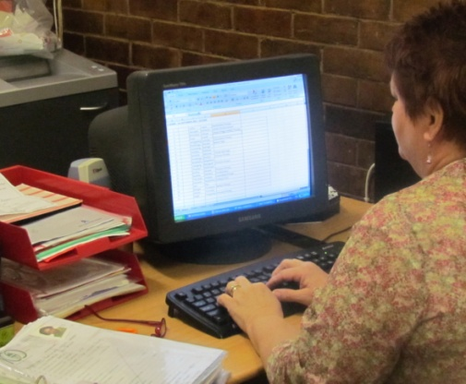
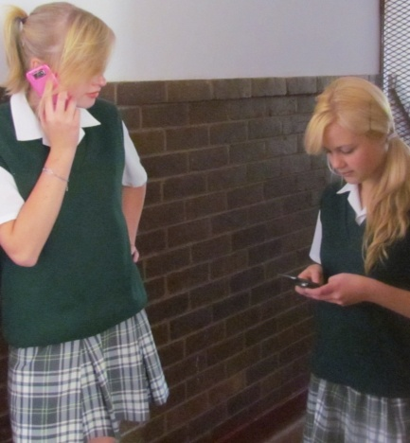
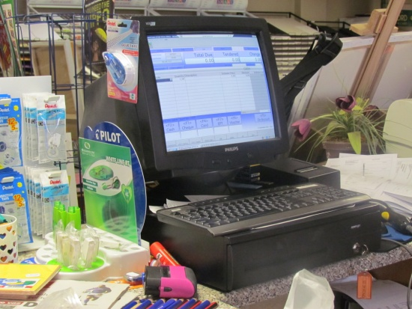
ICT SYSTEMS
Examples of ICT systems in everyday life
Computer system
Cellphone system
Point of Sale system
Customers, staff
Scanners
Servers, Cables
Credit card machines
Software
Processes
Hardware
Software
You (the user)
Data
Processes
Cell phones
SIM cards
Cellphone software
Cellphone towers
People

Slide 11
Ethical use of computers
Ways in which ICT can be used to act unethically
Theft: identity / data / computer time / piracy
Spreading false information – greater speed and reach
Creating malicious software: viruses, Trojans, worms, etc.
Why these things do not SEEM so bad (but they still are!):
Cannot see or touch things you are stealing
Don’t seem to hurt real people – faceless ‘numbers’
No one gets hurt physically – no potential for violence
Perceived justice – big companies just ‘rip people off’

Slide 12
TEST AND IMPROVE
Summary – concepts, terms and tips
Multi-purpose computers
Dedicated devices
ICT system
Economic reasons for using ICT
Ethical use of computers

Slide 13
Written module activity

